Slide 1


MAHENDRA INSTITUTE OF ENGINEERING
AND TECHNOLOGY
NAMAKKAL-637503
COMPREHENSIVE SYSTEM FOR IDENTIFYING AND MITIGATING FAKE SOCIAL MEDIA ACCOUNTS
Team Members:
R.RANJITH(611521104086)
A.D.TAMILSELVEN(611521104109)
S.P.VASANTH(611521104113)
J.VIGNESH(611521104114)
Guided by,
Mrs.P.BANUPPRIYA,M.E.,AP/CSE

Slide 2
ABSTRACT
Online social networks are increasingly influencing how individuals interact with each other by exchanging their private and professional data.
The social network is currently a common way to communicate with others that are spread across a variety of locations around the globe. When we speak about social networking then we can say that by sending them a request or readily sharing data with each other, anyone can readily make friends.
An individual user can have numerous accounts at various social networking locations to maintain in contact with their colleagues.
The project sheds light on the role of fake identities in sophisticated constant threats and includes the above approaches to identifying fake social media accounts.

Slide 3
INTRODUCTION
This surge in online scams is only helped by the presence of social media, which serves as one of the most popular platforms for scammers to target their victims.
Social media platforms such as Instagram,Facebook,Whatsapp, Twitter, have become the primary hub for scamsters, and these platforms facilitate their dangerous activities.
The fraudsters carry out such scams using fake accounts which help them hide their identity. To prevent such scams, we need a tool that helps us differentiate between fake and legitimate profiles.
Issues related to social media, such as confidentiality, online abuse, misuse, bullying, etc. are most used by fake accounts that appear to have been generated on behalf of organizations or individuals.

Slide 4
EXISTING SYSTEM
Depending on how many of your friends may have tags or connection histories, Facebook uses an algorithm to identify bots.
The aforementioned guidelines can be used to spot bot accounts, but they fall short when it comes to human-made false accounts.
Bot detection employs unsupervised machine learning.
In this technological method, information was compiled based on proximity rather than tagging.
Co-attributes made it possible for grouping functions to distinguish the bots so well. however, this approach was unreliable.

Slide 5
DISADVANTAGES
False positives/negatives
Genuine users might be misclassified as fake (false positives), or fake accounts might bypass detection (false negatives).
Privacy concerns
Collecting and analyzing user data can raise ethical and legal concerns regarding data privacy and consent.
Dependence on user input
The system's accuracy relies on the data provided by users, which can be manipulated or incomplete.

Slide 6
PROPOSED SYSTEM
Each profile (or account) in a social network contains loads of data such as gender, friend no., comment no., education, job etc. some of this data is private and some is public.
Since personal data is not available, we have used only government data to determine the false profile in the social network. we have regarded these data as characteristics of a profile for the classification of fake and true profiles.
The steps we have followed to detect fake profiles.
The network is able to verify blocks, nodes can create their own. as soon as a block is verified, it is added to the machine learning.

Slide 7
ADVANTAGES
automated detection system
Uses machine learning algorithms (like svm) and rule-based scoring to classify profiles as fake or genuine, reducing manual effort.
user-friendly interface
The web application allows users to input details like username, bio, and follower count and get instant results with visual feedback.
scalable and adaptable
Designed to be improved over time with ai integration and feedback loops for better accuracy and adaptability.

Slide 8
LITERATURE SURVEY
Bhoir et al., in (ieee 2020), discussed about the strength of the internet which has grown massively over the past decades, thereby giving paws to disinformation, which is a rising issue as it is the misinformation that makes it all too harder to discern the truth in material.
Therefore, the panacea is to provide a well thought and total proof device that tracks the various trends in the news that really can help us decide if it is true or not.
This design significantly decreased learning time and improved svm classifiers.
This Hybrid model performed well in comparison to the random forests (rf) algorithm and vector support operator when designed separately.

Slide 9
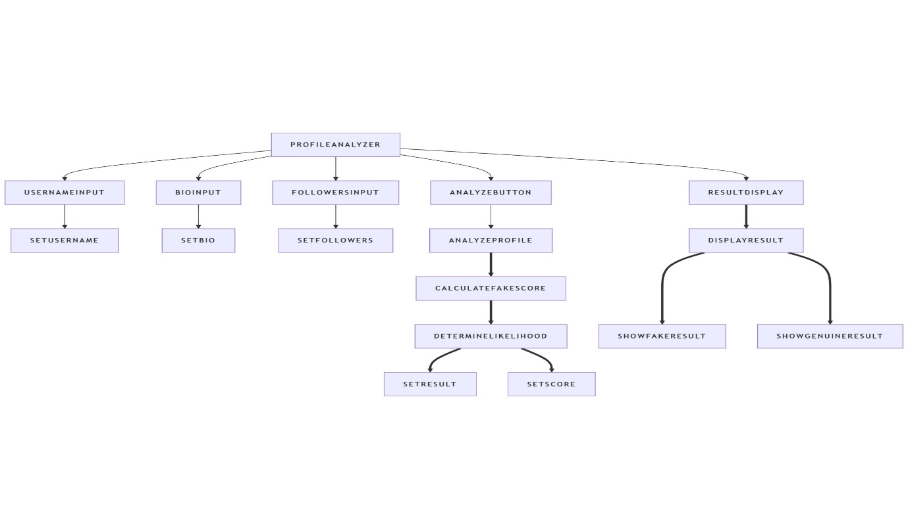
System Architecture

Slide 10
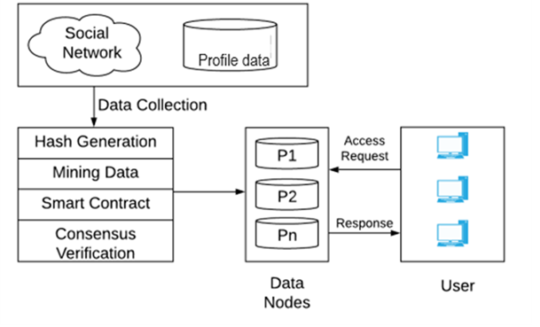
PROCESS DIAGRAM

Slide 11
PROBLEM STATEMENT
Online scams have surged, with social media becoming a key platform for fraudsters to target victims.
Scammers often use fake accounts to hide their identity, carrying out fraudulent activities on platforms like Instagram, Facebook, WhatsApp, and Twitter.
These fake accounts contribute to issues such as online abuse, bullying, and privacy violations, potentially harming reputations and reducing engagement for individuals and organizations.
To prevent such scams, a tool is needed to distinguish between fake and legitimate profiles

Slide 12
PLAN OF ACTION OF IMPLEMENTATION
Project Initiation
Requirements Gathering
Technology Selection
System Architecture Design
Development
Testing
Deployment
Documentation
Project Review and Closure

Slide 13
MODULE DESCRIPTION
Dataset collection the first step of detecting the fake account on facebook or twitter is collecting the data set of any of these two as per the availability.
The proposed work the data set of facebook or twitter is collected by survey method. by using the survey method we collect the data set of facebook or twitter from facebook or twitter users. for this purpose, we create a google form.
Google form consists of various types of questions that help us to accurately classify data-free accounts and fake accounts.

Slide 14
MODULE DESCRIPTION
MODULE 1:
Spam user detection.
MODULE 2:
Review system user feedback module.
MODULE 3:
Profile verification module.

Slide 15
MODULE 1:SPAM USER DETECTION
This module identifies spammy behaviors in users by analyzing their activity patterns.
Techniques and Features.
Profile Completeness: Spam accounts often have incomplete profiles. Implement a check for missing profile pictures, bio sections, and other key details.
Behavior Analysis: Detect users who perform actions like excessive posting, following/unfollowing in a short time, or sending repetitive messages.
Speed of Account Creation: Fake accounts are often created rapidly. Analyze the rate at which new accounts are created or verified.

Slide 16
MODULE 2: REVIEW SYSTEM FOR USER FEEDBACK MODULE
Allow users to report suspicious profiles, content, and reviews.
Techniques and Features.
Flagging System: Implement a system where users can report fake profiles, spam content, and abusive behaviors. Flagged content should be reviewed by admins or algorithms.
Community Voting: Let users vote on the legitimacy of reviews and profiles. Accounts with many negative votes can be flagged for further review.

Slide 17
MODULE 3:PROFILE VERIFICATION MODULE
This module helps to verify if a profile is legitimate.
Techniques and Features.
Phone Number and Email Verification: Require phone number or email verification to ensure that users are not creating fake profiles.
Identity Verification: Implement an identity verification process where users upload photos of themselves, which are then checked against their social media profiles.

Slide 18
CLASSIFICATION OF DATASET
The classification technique is applied after the clustering and feature selection technique.
Neural Networks and SVM are used for the classification of data. neural networks and SVM are machine learning techniques that efficiently work on different kinds of data sets.
The execution time of SVM is less because it takes less time to train Support Vector Machine.

Slide 19
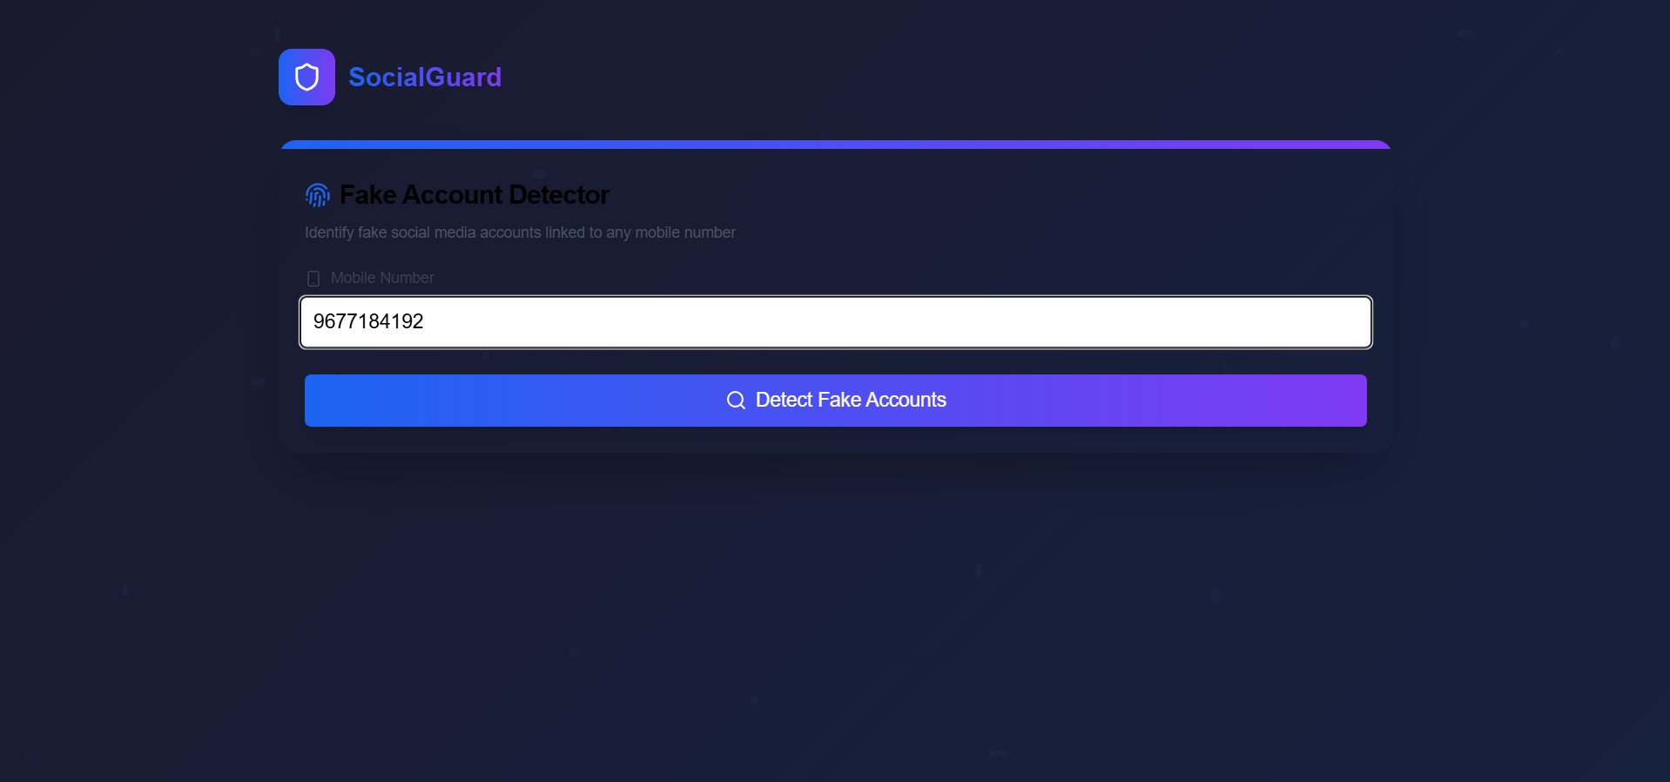
Sample Output

Slide 20
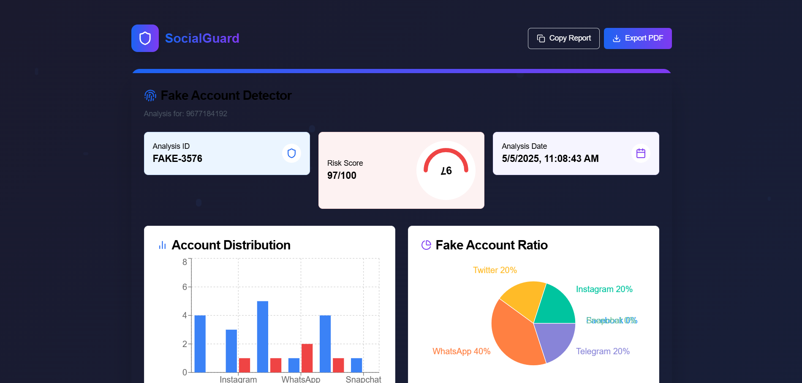

Slide 21
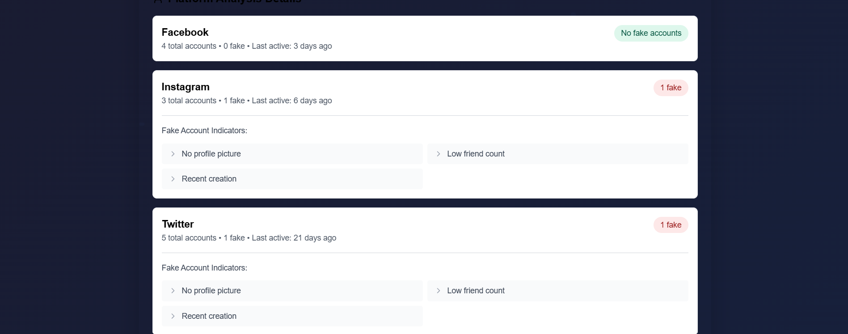

Slide 22
CONCLUSIONS
In conclusion, the proposed model uses custom and machine learning classification algorithms to detect fake profiles. Experiments show that custom parameters lead to minimal computation time during execution.
While the system framework is currently only partially deployed, future research aims to develop a fully operational real-time framework to identify and eliminate fake news effectively

Slide 23
REFERENCE
1. E. Karunakar, V. D. R. Pavani, T. N. I. Priya, M. V. Sri, and K. Tiruvalluru, “Ensemble fake profile detection using machine learning (ML),” J. Inf. Comput E. Karunakar, V. D. R. Pavani, T. N. I. Priya, M. V. Sri, and K. Tiruvalluru, “Ensemble fake profile detection using machine learning (ML),” J. Inf. Comput. Sci., vol. 10, pp. 1071–1077, 2020. P. Wanda and H. J. Jie, “Deep profile: utilising dynamic search to identify phoney profiles in online social
2. P. Wanda and H. J. Jie, “Deep profile: utilising dynamic search to identify phoney profiles in online social networks CNN” J. Inf. Secur. Appl., vol. 52, pp. 1 P. Wanda and H. J. Jie, “Deep profile: utilising dynamic search to identify phoney profiles in online social networks CNN” J. Inf. Secur. Appl., vol. 52, pp. 1–13, 2020.

Slide 24
Thank You

